Slide 1
Category review: Chips
August 2024
Retail Analytics
Brand note: If client logo is not required, use alternate title page layout right click slide thumbnail > Layout > Title

Slide 2
Notes:
To view Privacy video explaining how important data privacy is to Quantium, please click here: https://www.youtube.com/watch?v=Zq1QDAkoRzU
or here Q:\Company Reference\Brand & Design\Brand videos\Q Privacy.mp4
At Quantium, we believe that data is the behavioural footprint of humanity and that it has to be treated with the utmost care and responsibility.
Histories, attitudes, indeed lives are stored within it in ways that aren’t always apparent – and that’s what makes its potential so powerful.
To work with it responsibly, sensitively, we set ourselves the highest data privacy protection and governance standards.
We have spent 17 years perfecting privacy-by-design and secure-by-design principles. Central to this is not holding any personally identifiable information about people –
we neither receive it, and put the necessary protections in place to be unable to decipher it.
Every aspect of handling data is safeguarded: from its de-identification, to its encryption – data security is paramount and of the highest grade.
We pride ourselves on gaining the trust of iconic organisations around the world through years of securely working with their data,
and in turn the trust that builds with their stakeholders.

Slide 3
Executive summary
The sales have climbed up until the day before Christmas, which is a good opportunity to capitalise on this momentum with special offers to boost the purchases. However, the sales also decreased after Christmas.
Mainstream young singles/couples contribute most to the sales.
Older families and young families, who make up our target market for sales, purchase more chips overall for all three Life stages.
01
Chips Category Review
To replicate the previous performance of the chosen trial stores 77,86 and 88, control stores 233, 155 and 237 were created.
Following the implementation of the new shop design, the trial store's effectiveness and the control store were contrasted.
During the trial period, the trial in stores 77 and 86 differed considerably from the control store in terms of both sales and customer count.
However, as compared to its control shop, the increase for trial store 88 was not that substantial.
02
Trial Store Analysis

Slide 4
01
Category

Slide 5
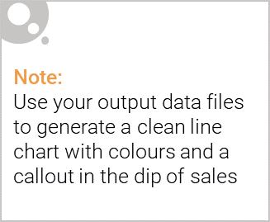
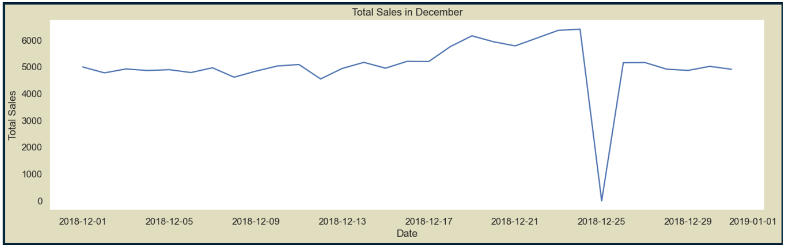
As Christmas approaches, sales gradually grow. On New Year's Eve, they resume their early December levels. However, because stores were closed for Christmas, there were no sales on December 25 as indicated by the dip.
The dip indicates the zero transactions due to the holiday store closures.

Slide 6

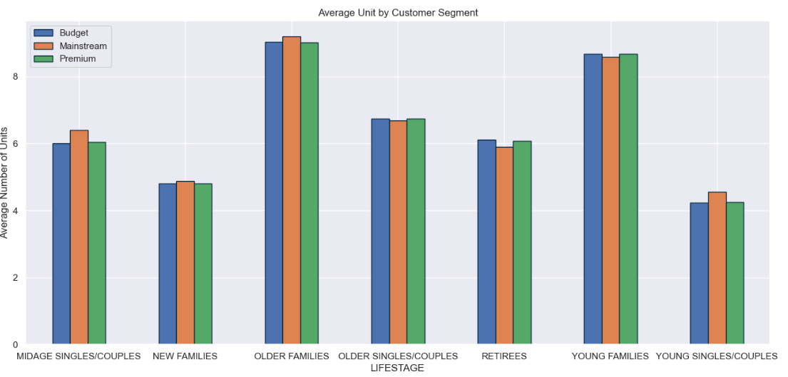
Each individual life stage profile shows a constant level of affluence; older & younger families are the buyers that make the largest average transactional purchases.

Slide 7
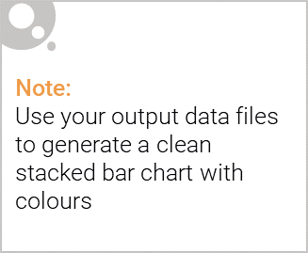
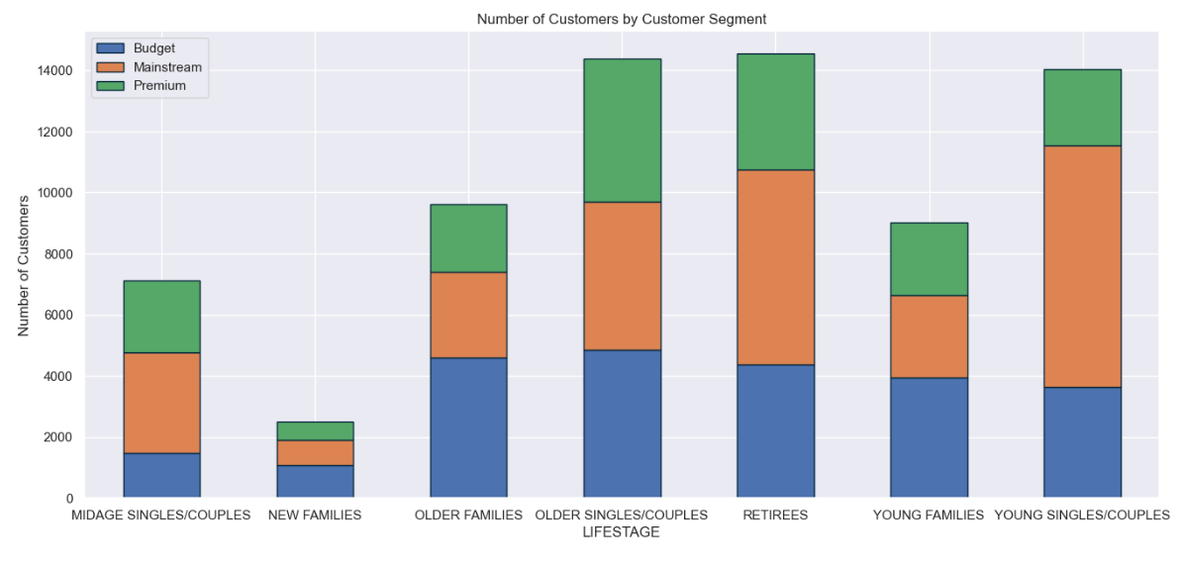
Editable (delete this)
The majority of mainstream young singles and couples purchase snacking chips, while mainstream retirees also make up a sizeable component of this market.

Slide 8
02
Trial store performance

Slide 9
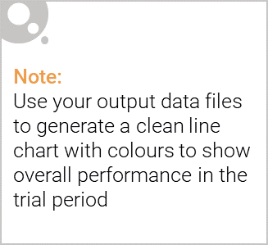
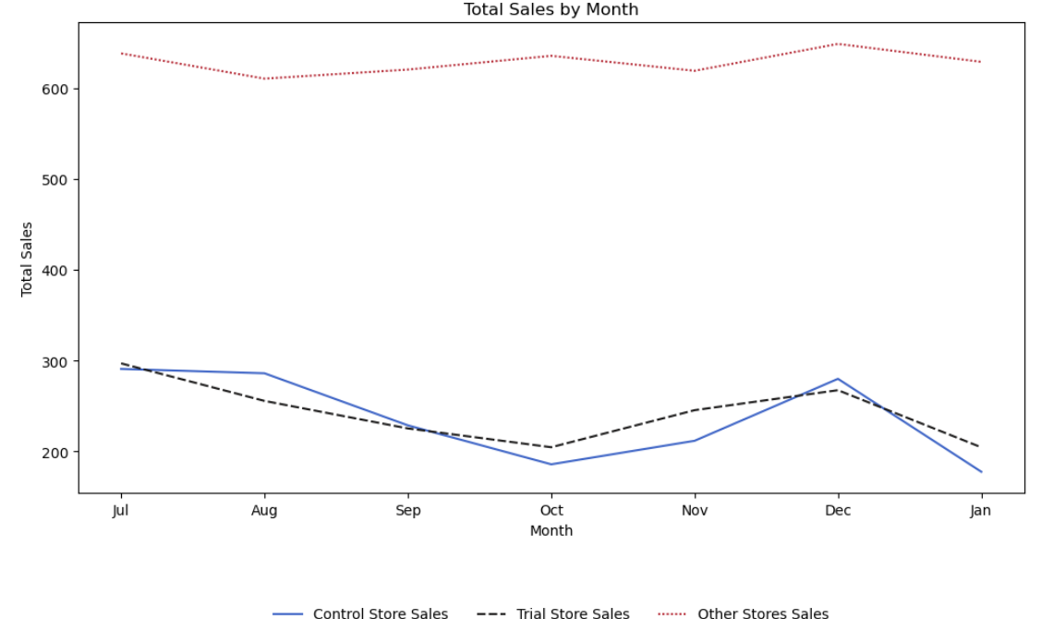
The trial store's performance in terms of total sales and customer count are reflected in the Control stores, whereas it is not exhibited in the other stores.

Slide 10
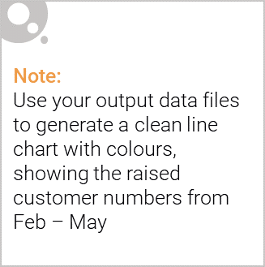
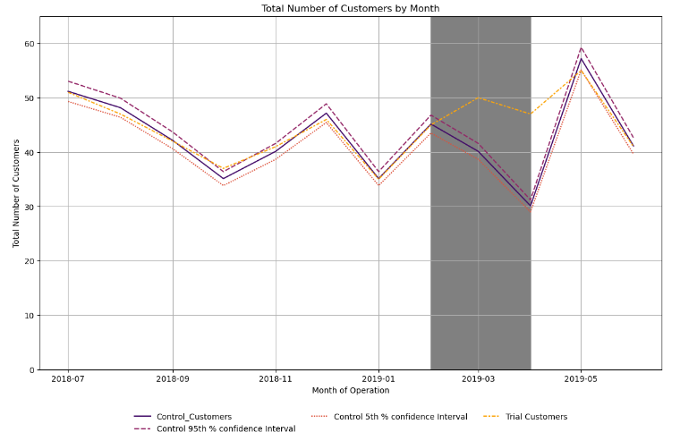
Trial shops 77 and 86 significantly outperformed Control stores 233 and 155 in terms of both total sales and the number of customers they attracted throughout the trial period. The performance improvement at the 88th trial shop, however, is modest.
Trial Period

